Slide 1


PLANNING FOR THE FUTURE
Investing in strong strategic spatial planning to ensure the delivery of the critical infrastructure
info@opr.ie
PlanningReg
Anne Marie O’Connor
Deputy Regulator
www.opr.ie
company/office-of-the-planning-regulator

Slide 2
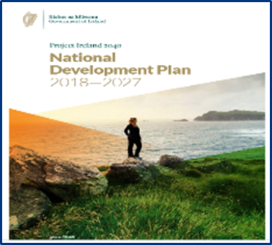
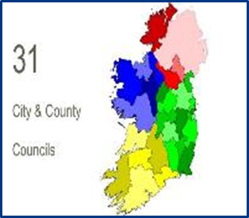

OPR Functions
Statutory Plans
Assessment of city/ county and local area plans made by local authorities for fit with national and regional policy and legislative requirements
Local Authority Reviews
Reviews and examinations of local authority and An Bord Pleanála systems and procedures in the delivery of planning services to the public
Research & Training
Building knowledge and information base in planning through training for local authority members and staff, public information, research
Notes:
In existence for 4 years. All but 3 of the 31 DPs have gone through the new system. Built up quiet a bit of experience over that period in terms of implementing policy – not easy. First time detailed oversight of plans & also through up areas where policy wasn’t clear enough or up to date.
Today, I’m going to talk to you about our experience to date around the delivery of infrastructure, the challenges or impediments to that and what the OPR is doing in the space.
Also ABP experience – example

Slide 3


Global Context
Many global challenges – climate – poverty – housing - instability - uncertainties
Ireland: exceptional economic performer – innovative – responsive - stable
Competitors: Advanced Economies – Rules Based Societies – Clarity - Stability

Slide 4



Ireland today
Growing population/decreasing household size / Economic challenges in delivering sustainable housing
High levels of economic growth / Need to reduce GHG emissions / Energy security vulnerability
Addressing Infrastructure under-investment legacies – Water – Energy – Transport
Notes:
Population – 1861 5.8m
1970 – av hhd size 4.1 = 25 homes
2022 - 2.44 = 41 homes - increase 40%

Slide 5

Planning system
Notes:
€165 Bn NDP + private sector; Resources - staff levels

Slide 6
Resourcing
Staffing
1550
Local Authorities
200 ABP
< 100
DHLGH/ OPR/ other
Funding
22% cost recovery
Notes:
What does that look like

Slide 7

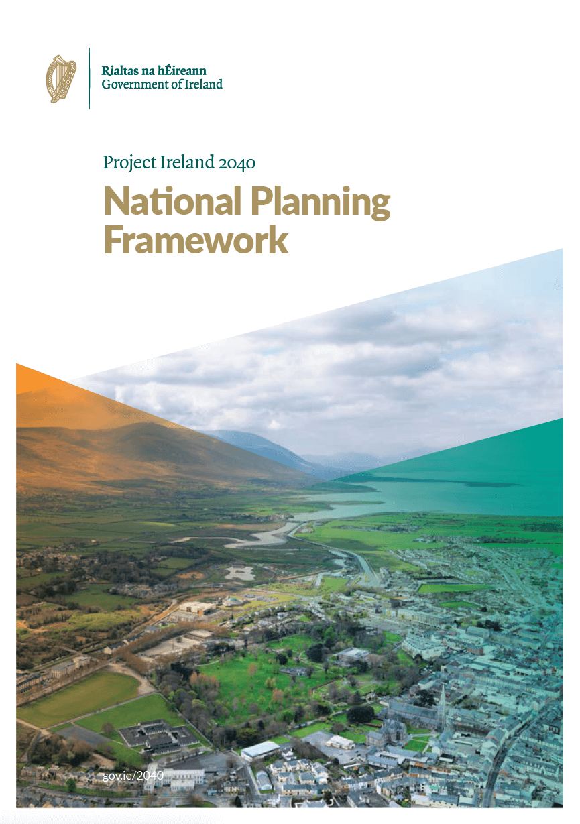


Changing Context
Climate Action
Plans
OPR as the
independent
oversight body
2019
Draft Planning
and
Development
Bill 2022
National Planning
Framework
National Development Plan
Notes:
Changing a Plan led system
Bill – main change is around strengthening the plan-led approach. Better and clear structure for policy driven plan-led development. 10 year CDP – more strategic. S.28 guidelines.

Slide 8
Plan-led planning process
Key issues thoroughly assessed – Big decisions made early
Proper evaluation of alternatives – move away from zero/sum game
Harder decisions early = Greater certainty later
Thinking through/proper process: less risk of JR overturn
Notes:
Making choices – in the right circumstances
More aligned to other member states

Slide 9



Challenges
Policy
Skills and Expertise
Resources
Notes:
If moving to a more policy based approach – first question, how’s the policy shaping up

Slide 10
Policy
Clear policy – hallmark of a rules based society
OPR demonstrates Government commitment to rules based approach - not a policy maker
Policy works where very clearly articulated and implementation worked through
Success:
  Policies carefully developed with proper stakeholder engagement
  Relevant issues and implementation properly considered and assessed
  Planning: Ministerial Guidelines - National Planning Framework - Regional Spatial and Economic Strategies complement and reinforce each other
Notes:
Policy implementation – not always easy

Slide 11
Development Plan Policy - OPR Interventions
Directions issued to local authorities
OPR Recommendation
Minister Decision
Notes:
Where OPR identifies a breach of policy

Slide 12
Ministerial Directions
Renewable Energy
Wastewater infrastructure
Protect efficiency and capacity of national roads and junctions
School sites & education facilities
Airport infrastructure
Successes
Challenges
Notes:
Renewable Energy set back distance - aois, Westmeath, Donegal
Sludge Management Facility in Tuam/ Ballinasloe & WWTP Carraroe
Cork City Docklands 25,000 people
Roads - Cork County, Fingal, Mayo, Kerry
Success –Policy support for mid & eastern water supply project; renewable energy
Roscommon (set back + target)
More difficult - RE

Slide 13
Renewable Energy
Set back distances
Renewable energy targets
  2006 Wind Energy Guidelines & 2017 Interim Guidelines on Renewable Energy & Climate
  National & European energy policy under development
  Revision to methodology for local authorities (LARES)
  Development of a framework for meeting national targets (regional)

Slide 14
Skills and Expertise
Marine
Policy
Habitats & Biodiversity
Law
Notes:
Marine – marine ecology & ecosystems; coastal zone erosion

Slide 15
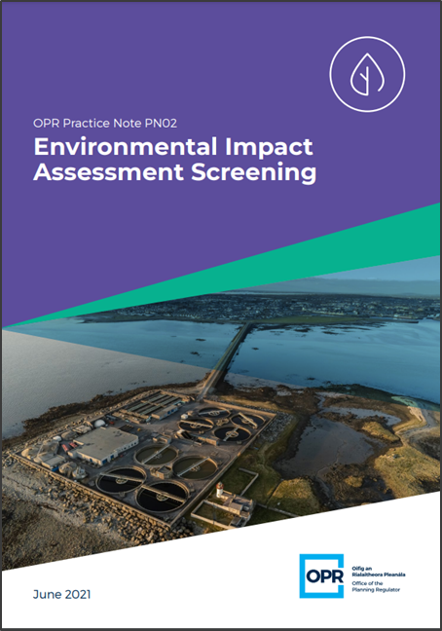

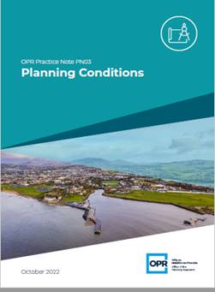

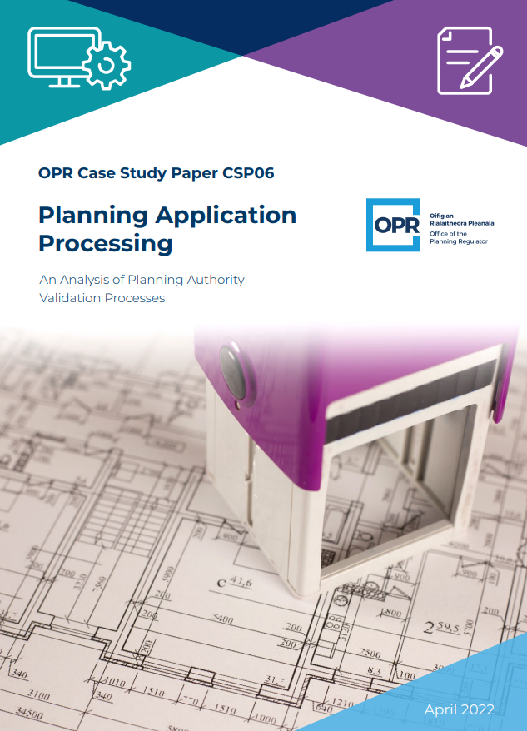

OPR Research & Training
Improve standards and consistency
Provide practical tools
Shared learnings
Notes:
Research – An Foras 1986
Training – first time

Slide 16
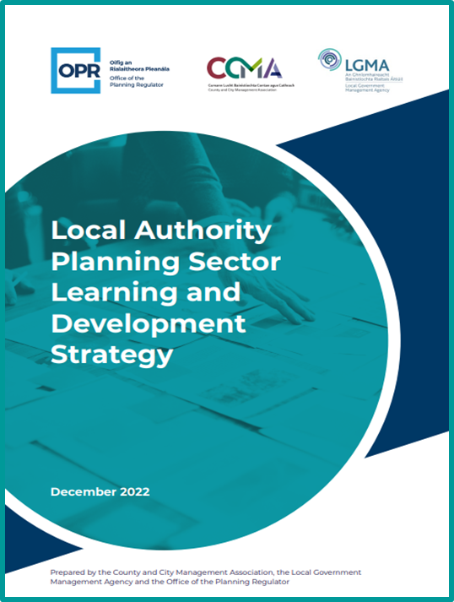
OPR Research & Training
Training for Local Authority staff
– to be extended to ABP
Training for Elected members
We share learning from the reviews with DHLGH to inform policy making, to highlight best practice and to raise any issues.
Notes:
Staff – Flood risk management; Marine planning

Slide 17
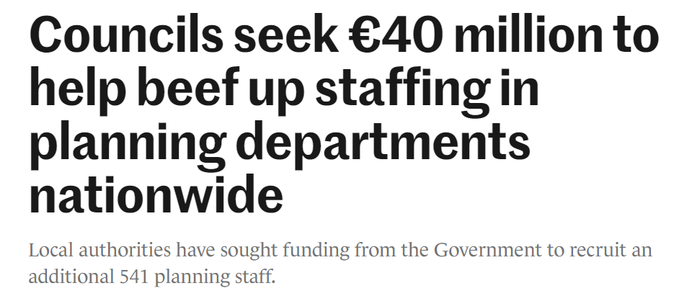
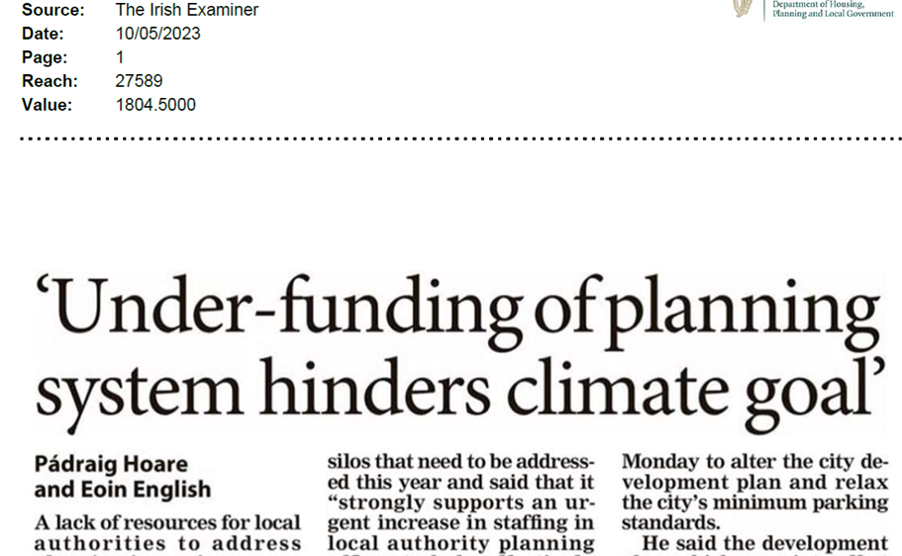
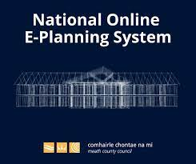
Resources
Notes:
National Climate Advisory Council’s report
Local Government Mangt Association – report: 33% increase = more than 550
Not just people – technology – digital delivery of service
Cannot stress enough how critical the issue of resourcing is. Cannot more to an evidence based plan-led system under current resourcing levels

Slide 18
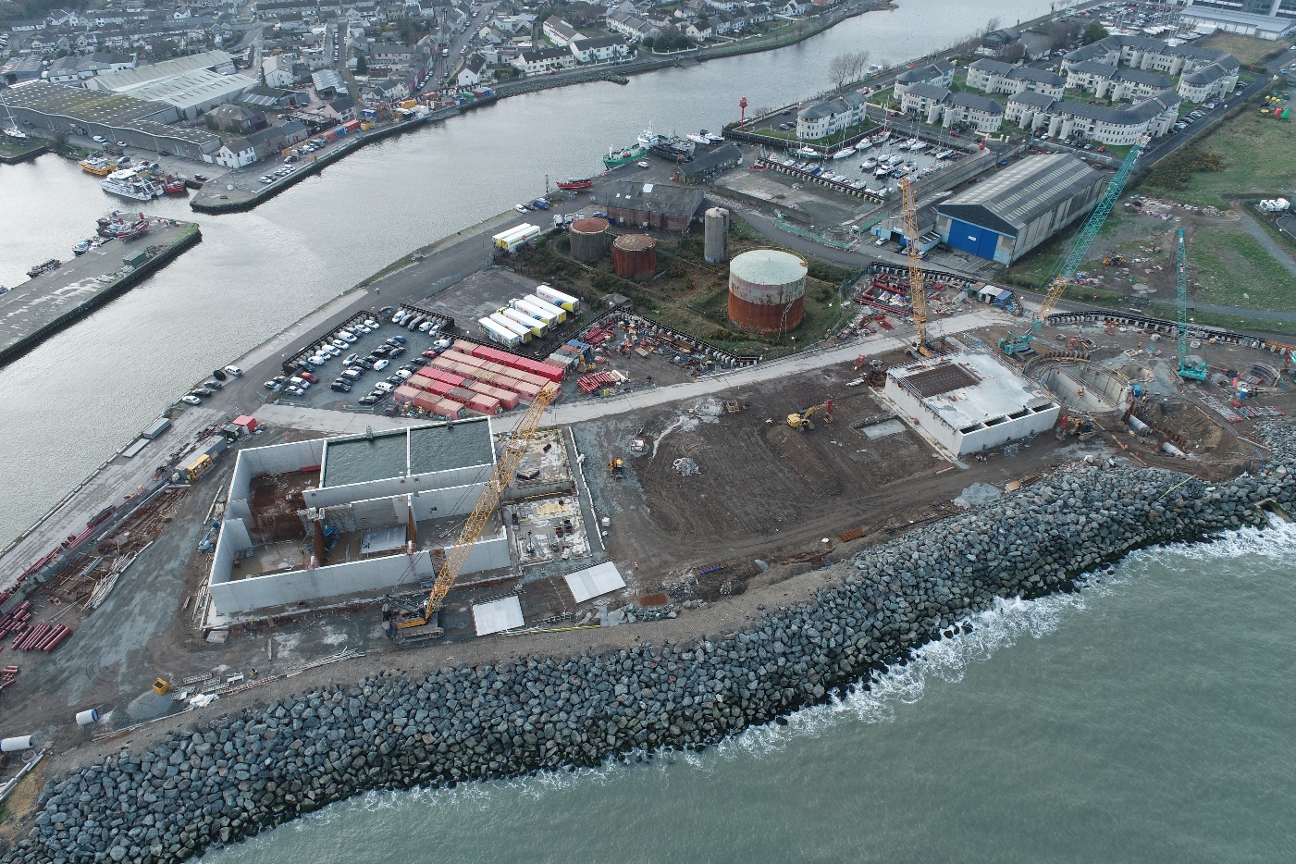
Arklow Wastewater Treatment Plant
Notes:
Lots of bad press about the planning system, Example of where it was successful. Thanks to Olwyn James

Slide 19
First attempt
Planning application
Planning application
Legal Challenges conclude
Planning permission expires
1993
1999
Legal Challenges
2014
2015

Slide 20
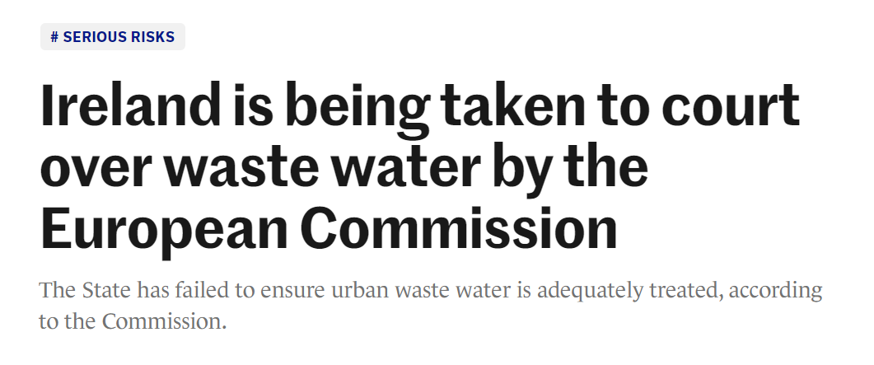
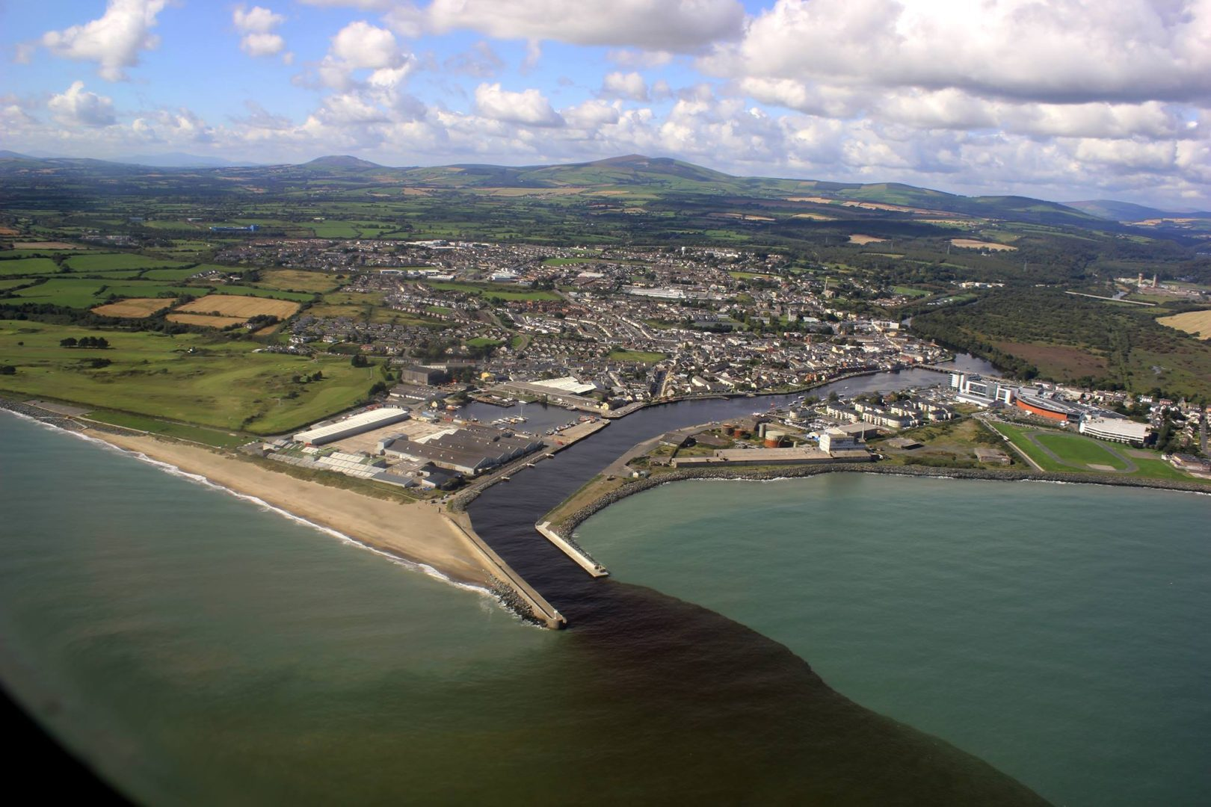
Meanwhile…..

Slide 21
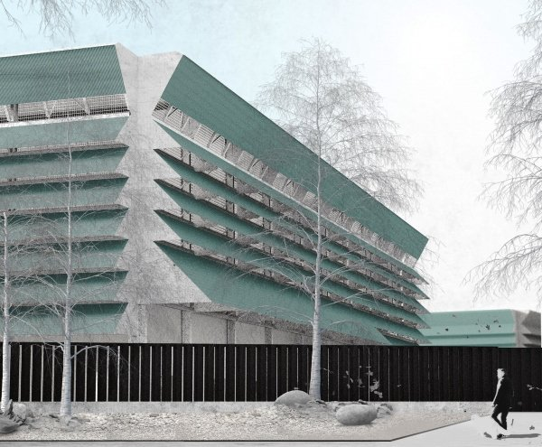
Change of Approach
Public Engagement
Site selection – energy/ climate considerations
Urban site - proximity to residential
ABP SID pre-app
Development Plan Policy
Design solution
Planning permission (+CPO) – 13 months, including Oral Hearing
2021 construction commenced
Inceptor sewers constructed with OPW Flood Relief Scheme
2025 completion
Lesson: engage with planning policy
Notes:
260 page report; WWTP – wallboard gypsum factory; 1km interceptor sewers along northern and southern bank of Avoca River and traversing river 130m; pumping station; outfall pipe 1km; EIA; AA; CPO; protected structures

Slide 22
Conclusions
Planning process central to tackling interrelated societal, environmental and economic issues…
Bypassing proper planning = bigger delays in the long run..
Focus now on rapid strengthening of planning system capacity to deliver…
Critical Measures:
  Clearer Policies: e.g. translation of climate to planning targets (renewables, compact growth)
  Resourcing: ABP Action Plan – LA Strategic Workforce Plan – MARA – Environmental Court
  Upskilling existing planning staff & members: New LA Planning Services Training Group
  Expanding Higher Education numbers
Notes:
Planning process – must be acknowledged and supported
Bypass policy or plan

